Slide 1
Building an Effective Site-Council
Dr. Brian Jordan
Director of Leadership Services, KASB

Slide 2
Outcomes
Discuss why site councils exists
Define the role of site councils
Outline how site councils should function
Analyze the key focus areas of site councils

Slide 3
When did Site Councils begin?
In 1992, the Kansas legislature enacted K.S.A. 72-6439, a state statute that instituted the Quality Performance Accreditation (QPA) system.

Slide 4
How have Site Councils roles changed since 1992?
Site Based → Systems Based
Site Goals → District Goals
Old QPA → 5 R’s
Total Autonomy → Defined Autonomy
Local Standards → State Standards
ESEA → NCLB → ESSA

Slide 5
Why do Site Councils exist?
School Improvement
Monitor Site Performance
Assess Needs
Set Priorities
Identify Issues and Barriers
Recommend
Advocate

Slide 6
Why do our Site Councils exist?
How can Site Councils be a support
for our educational system?

Slide 7
Who is the Site Council?
Licensed/Classified
Parents
Community At-Large
Business Representatives
Principal

Slide 8
How is the Site Council connected to the School Board?
Names submitted to board to be considered for appointment
Board appoints members
Make recommendations, if necessary
Serve as a communication channel

Slide 9
How are meetings conducted?
Elected chair manages meeting
Agenda developed and adopted
Minutes taken, approved at following meeting
Agenda and Materials sent to members prior to meeting
Operate under Kansas Open Meetings Act
Should meet at a minimum quarterly

Slide 10
What topics should Site Council cover annually?
By-Laws
District and building goals as defined for KESA
Progress towards
established goals

Slide 11
How is the structure of Site Council described different or similar to our current council?
What do we need to address?

Slide 12
What does the work of a Site Council look like?
Review progress on Annual Measurable Objectives
Monitor implementation of Common Core
Review ESEA waiver impact on school
Study changes in accreditation process
Determine ways to engage community in education process

Slide 13
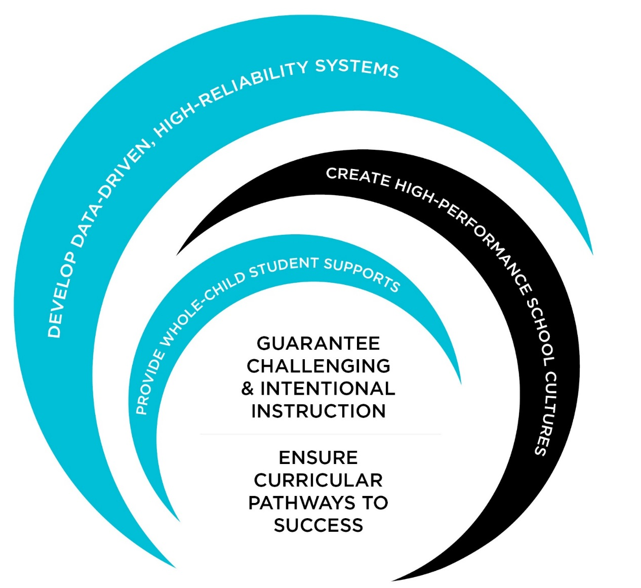
What Matters Most Framework ®
Changing the Odds of Success for All Students
Notes:
SECTION HEADER
Objective:
Introduce the What Matter Most Framework as a way to organize the Focus of Leadership
Script:
There are a variety of influences on student learning. McREL conducted seminal research that identified a number of factors (Marzano, 2003) that demonstrated a statistically significant effect on student learning. Those factors that we found to have a statistically significant effect on student achievement were organized in three categories
school-level practices,
classroom-level practices, and
student characteristics.
The What Matters Most Framework contains our findings (factors) from our original studies (Marzano, 2003), yet includes additional and current quantitative and qualitative research that confirm our findings (Hattie, 2009) and offer a more robust way to organize best practices that offer the best opportunity to improve school outcomes and increase student achievement. Strong leadership significantly affects the degree to which these practices are exercised successfully.
To organize the myriad of expectations and initiatives, we will spend the remainder of our time unpacking the key elements of the What Matters Most Framework. This framework will help leaders and leadership teams identify potential opportunities on which to focus, that meet the primary job of the principal, to increase instructional quality among classrooms.
Notes:
This is a section header.
References:
Goodwin, B. (2011). Simply better: Doing what matters most to change the odds for student success. ASCD.

Slide 14
Classes
Student involvement
Discipline reporting
Homework policies
Handbooks
Courses
Opportunities
Advanced Courses
Technology
Supports/Remediation
Students
Educational Program
Physical Plant
Personnel
Communication and Culture
Classrooms
Labs
Library
Technology
Meet Staff
Support Staff
Staff support
Staff programs
Instructional/program demonstrations

Slide 15
What does the work of a Site Council look like?
Advocating for Your School
Step 1 - Know the issues
Step 2 - Know your district
Step 3 - Know where you stand
Step 4 - Know the decision-makers, especially those accountable to you
Step 5 - Know how to contact decision-makers
Step 6 - Know the calendar for decision-making
Step 7 - Know how to state your case
Step 8 - Know how to reach the public
Step 9 - Know your role in the electoral process

Slide 16
What are the key areas of work for your building’s site council to focus on to align with the district vision and direction?
Why are these the key areas?

Slide 17
A Site Council…
…can
provide advice and counsel to the school in developing, implementing, and evaluating school improvement efforts
provide ongoing support for the students and staff of the school
make recommendations regarding budgetary matters
assist school boards analysis of the unique environment of schools
enhance the efficiency and maximize limited resources
advocate for the educational needs of their community

Slide 19
A Site Council…
…can
provide advice and counsel to the school in developing, implementing, and evaluating school improvement efforts
provide ongoing support for the students and staff of the school
make recommendations regarding budgetary matters
assist school boards analysis of the unique environment of schools
enhance the efficiency and maximize limited resources
advocate for the educational needs of their community

Slide 20
A Site Council…
…can NOT
be involved in personnel hiring or other matters related to personnel
develop and administer their own surveys without board consent
develop building policy or procedures
purchase supplies, equipment, etc., or conduct fund raising on the schools behalf
access personal information of students or staff
make decisions the site council is advisory only; it can only make recommendations

Slide 21
Develop Local Leadership Capacity
Support and seek innovation
Assist in finding efficiencies
Engage parents and the public
Raise awareness of challenges facing schools
Draw attention to successes of schools

Slide 22
After discussing effective site councils….
What are your next steps?
Who is responsible for carrying
out next steps?
When will the next steps be
completed?

